Slide 1
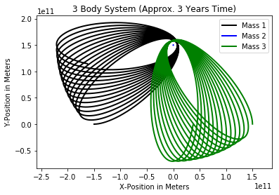
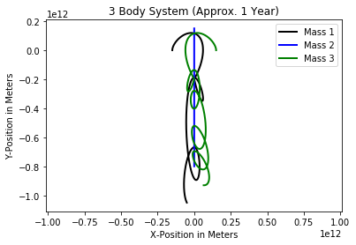
3-Body Problem
By: Taylor Larrechea

Slide 2
Goal of Project
Be able to plot the motion of three bodies in space orbiting one another.
Find a stable system in which these orbits repeat or determine if these can be stable.

Slide 3
Stability in Orbits
Non-Chaotic orbits are considered to be stable.
These stable orbits have repeatable, or almost repeatable orbits that do not differ much from the previous orbit.
Chaotic orbits are considered to be unstable.
There is no pattern or predictable path in unstable orbits.

Slide 4
Building up to 3-Body: Projectile Motion
A ball is dropped from rest at a specific height. The position of the ball can be plotted and solved for with the use of ODEINT in python.
Once the motion extends to multiple directions, ODEINT can be used but it was not intuitive enough for me to use. Instead, a numerical integration method was used.
In particular a Forward Euler Difference Scheme was used to solve the differential equations for the 2-body motion and the 3-body motion.

Slide 5
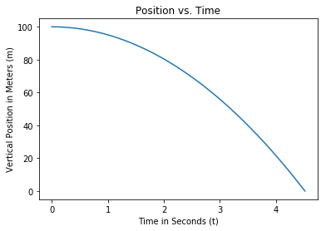
Building up to 3-Body: Projectile Motion
The simplest scenario must first be examined. This scenario of course is projectile motion.

Slide 6

Building Up to 3-Body: 2-Body Equations
Newton’s force equation and Gravitational force equation:
$\vec{F}=m\vec{a}$
$\vec{F}= \frac{Gm_{1}m_{2}}{r^{2}} ∙\vec{n}$
Combining the equations so that they can be solved there are now separate equations for the x and y components of force. Looking at the equations for acceleration for mass 1,
$a_{1x}=\frac{Gm_{2}}{r^{3}}∙x, a_{1y}=\frac{Gm_{2}}{r^{3}}∙y$
Analogs can be derived for the other mass in the system.

Slide 7
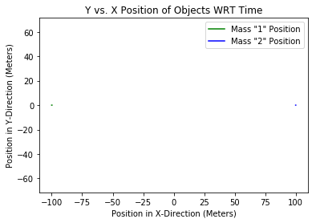
Building up to 3-Body: 2 Bodies in Space
Two bodies in space of arbitrary mass and an arbitrary distance apart have only the force of gravity acting on them.
The purpose of this example, along with the projectile motion, is to baseline the code for the more complex scenarios in the project.

Slide 8
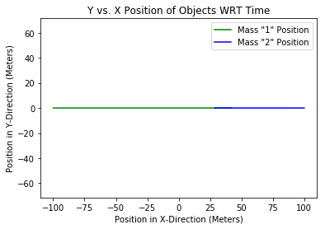
Building up to 3-Body: 2 Bodies in Space
If the code is working correctly, the two bodies of mass should attract one another.
This example was set up so that the two bodies of mass in space are not of equal mass. 50 kg for Mass 1 and 100 kg for Mass 2.

Slide 9
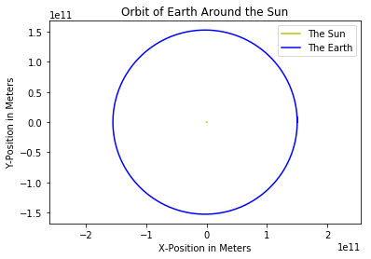
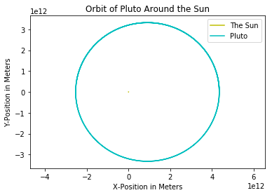
Building up to 3-Body: 2-Body Orbits
Now that the code is working to this point, the next step is to extend to orbital motion.
Planetary orbits like the Earth and Pluto were examined.

Slide 10
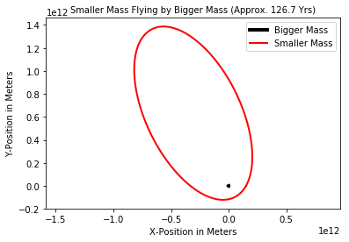
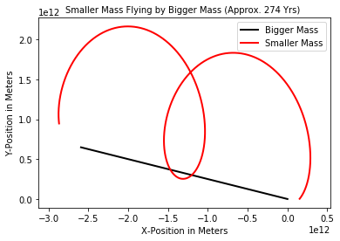
Building up to 3-body: more intricate 2-body motion
Some quick notes: The black body in this system is about 1.5 million times greater than the red bod.
Smaller mass is moving at 3,500 m/s in the y and 2,000 m/s in the x.

Slide 11

3-Body Motion: Equations
All the prerequisites have been met to now solve the 3-body system. First, the equations that are going to be solved.
$m_{1}\vec{a_{1}}=−\frac{Gm_{1}m_{2}}{{r_{12}}^{2}}∙\vec{n}−\frac{Gm_{1}m_{3}}{{r_{13}}^{2}}∙\vec{n}$
$m_{2}\vec{a_{2}}=−\frac{Gm_{2}m_{1}}{{r_{21}}^{2}}∙\vec{n}−\frac{Gm_{2}m_{3}}{{r_{23}}^{2}}∙\vec{n}$
$m_{3}\vec{a_{3}}=−\frac{Gm_{3}m_{1}}{{r_{31}}^{2}}∙\vec{n}−\frac{Gm_{3}m_{2}}{{r_{32}}^{2}}∙\vec{n}$
The above three equations were solved for with the use of the Forward Euler Difference Scheme.

Slide 12
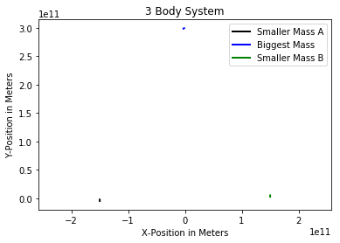
3-Body Motion: One body At Rest
In this first scenario, the 3 bodies are positioned in a triangle position originally.
All plots to follow initially start in the same configuration.

Slide 13
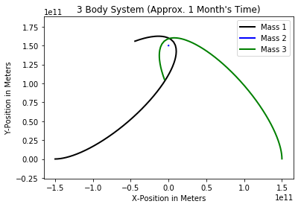
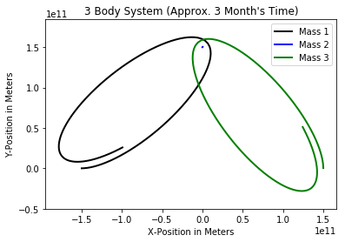
3-Body Motion: One Body At Rest
In this example, the black and the green mass are both around the mass of the Earth and the blue mass is around the mass of the sun. The black mass was set in motion with a velocity of 30,000 m/s in the x-direction where as the green mass was set in motion with a velocity of 30,000 m/s in the y-direction. The following plots were generated with these conditions.

Slide 14
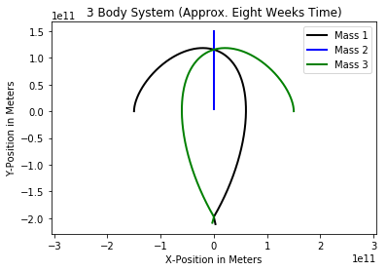
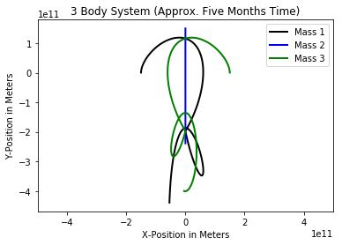

3-Body Motion: all Bodies Moving
In this scenario the black and the green masses were resized to $6.0∙{10}^{26}$ kg and the blue mass was changed to $2.0∙{10}^{31}$ kg. Both the black and green masses were sent initially in the Y-direction at 30,000 m/s and the blue mass was sent in the negative Y-direction at the same speed.

Slide 15
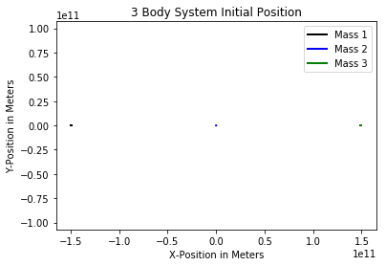
3-Body Motion: As Stable As She Gets
The last system that we wish to look at is the stable 3-body system. In this system the masses are all rearranged to different initial positions from before, with different masses, and different initial velocities.

Slide 16
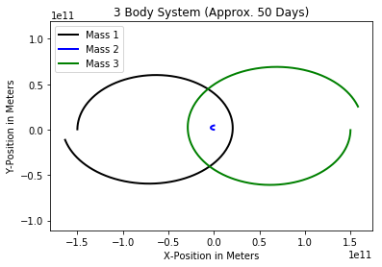
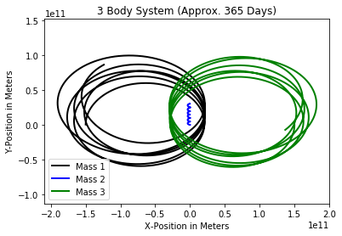
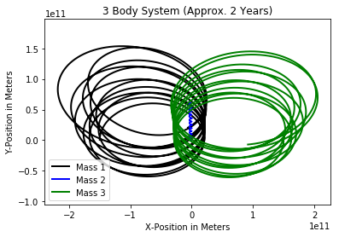

3-Body Motion: As Stable As She Gets
The black and the green mass were changed to $2.0∙{10}^{29}$ kg where the blue was changed to $2.0∙{10}^{31}$ kg. The black and the green mass were originally set in motion with the black traveling at 50,000 m/s in Y-direction and the green traveling at 50,000 m/s in the negative Y-direction.

Slide 17
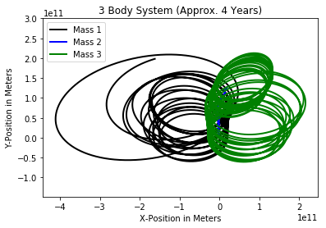
3-Body Motion: As Stable As She Gets
This motion originally looks promising and stable, but as time goes on the stability of the orbit decreases tremendously and the unpredictable orbits ensue.

Slide 18
Conclusions
Some systems that begin somewhat stable decay to unstable orbits over time.
Infinite solutions to three-body problem.
In general, how to start coding a project numerically.

Slide 19
Questions ?

